Slide 1
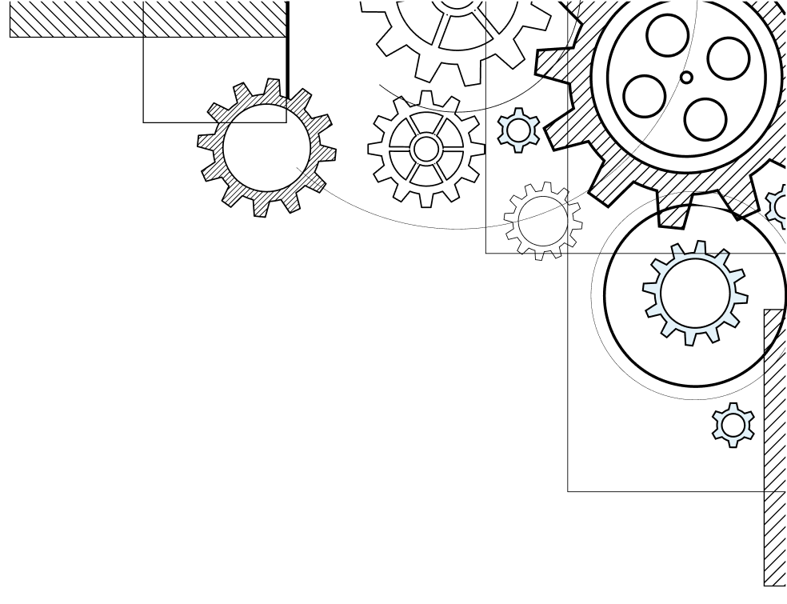



IBM AGENTIC AI PROJECT
AI powered Career
guidance using agentic ai
PRESENTED BY: TEAM ANONYMOUS
GROUP MEMBERS: 1) Maitreya Pawar 2) Nishant Narudkar 3) vatsal Parmar
4) Saksham Shukla
5) aamir sarang
COLLEGE: RAMRAO ADIK INSTITUTE OF TECHNOLOGY

Slide 2

Problem Statement
OUR SOLUTION
01
02
Defines the key issue faced by learners in identifying skill gaps for job roles.
Explains how our AI system solves the problem through personalized guidance.
Table of Contents
SDG GOALS
AGENTIC AI ARCHITECTURE
03
04
Shows how the project supports UN Sustainable Development Goals
Outlines the intelligent agents used to analyze resumes and recommend learning paths.
TECH STACK
CONCLUSION
05
06
Lists the core technologies, frameworks, and tools used to build the project.
Summarizes the outcomes, impact, and future scope of the solution

Slide 3


CORE CHALLENGES
– Users don’t know what specific skills they’re missing for their desired job roles. – There’s no easy way to assess their current skill set against industry requirements. – Learning paths are often confusing, non-personalized, or incomplete ones.
PROBLEM STATEMENT
Students and job seekers have access to a wide range of online learning platforms ,However, these platforms offer general course recommendations without understanding a learner’s current skill level or career goal.
WHY IT MATTERS
This lack of clarity leads to wasted time, scattered learning, and slower career progress — especially for freshers and career changers trying to enter competitive tech roles like Data Scientist, Web Developer, or Cloud Engineer.

Slide 4

OUR SOLUTION
AI Career Pathfinder Agent bridges this gap through an AI-powered
Key Capabilities:
Built using Agentic AI principles to simulate decision-making and goal-based planning.
Upload resume or manually input skills
Choose target job role
Detect skill gaps intelligently
Generate a curated, personalized learning roadmap

Slide 5
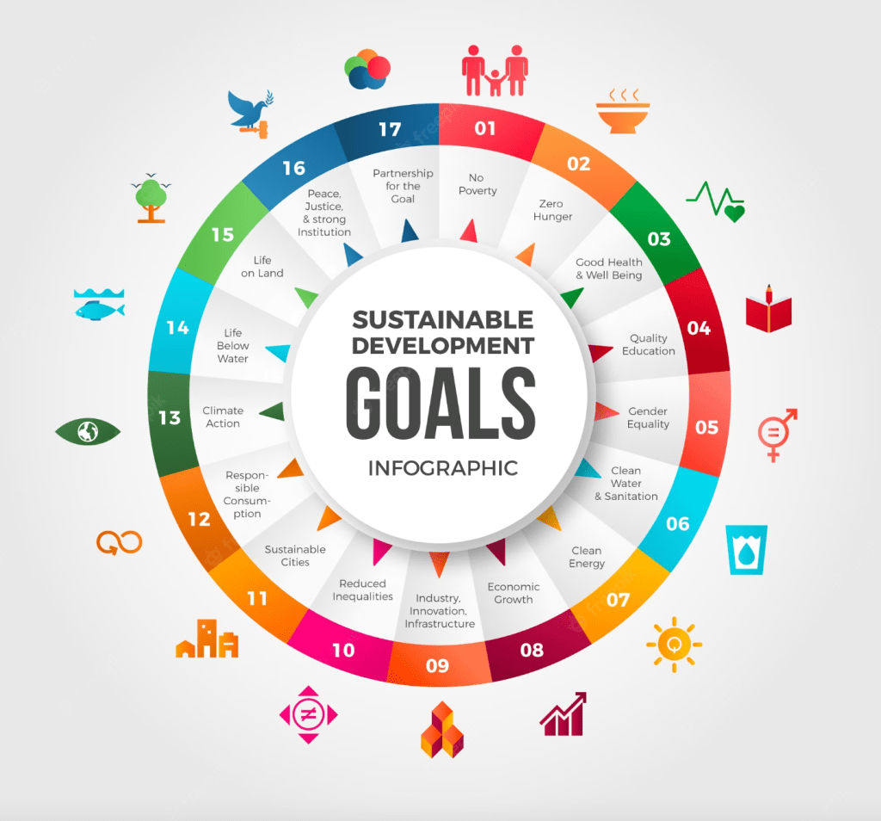




Alignment with SDG goals
SDG 4
Quality Education- promotes personalized and accessible skill development
SDG 8
Decent Work & Economic Growth – improves career readiness and reduces unemployment

Slide 6
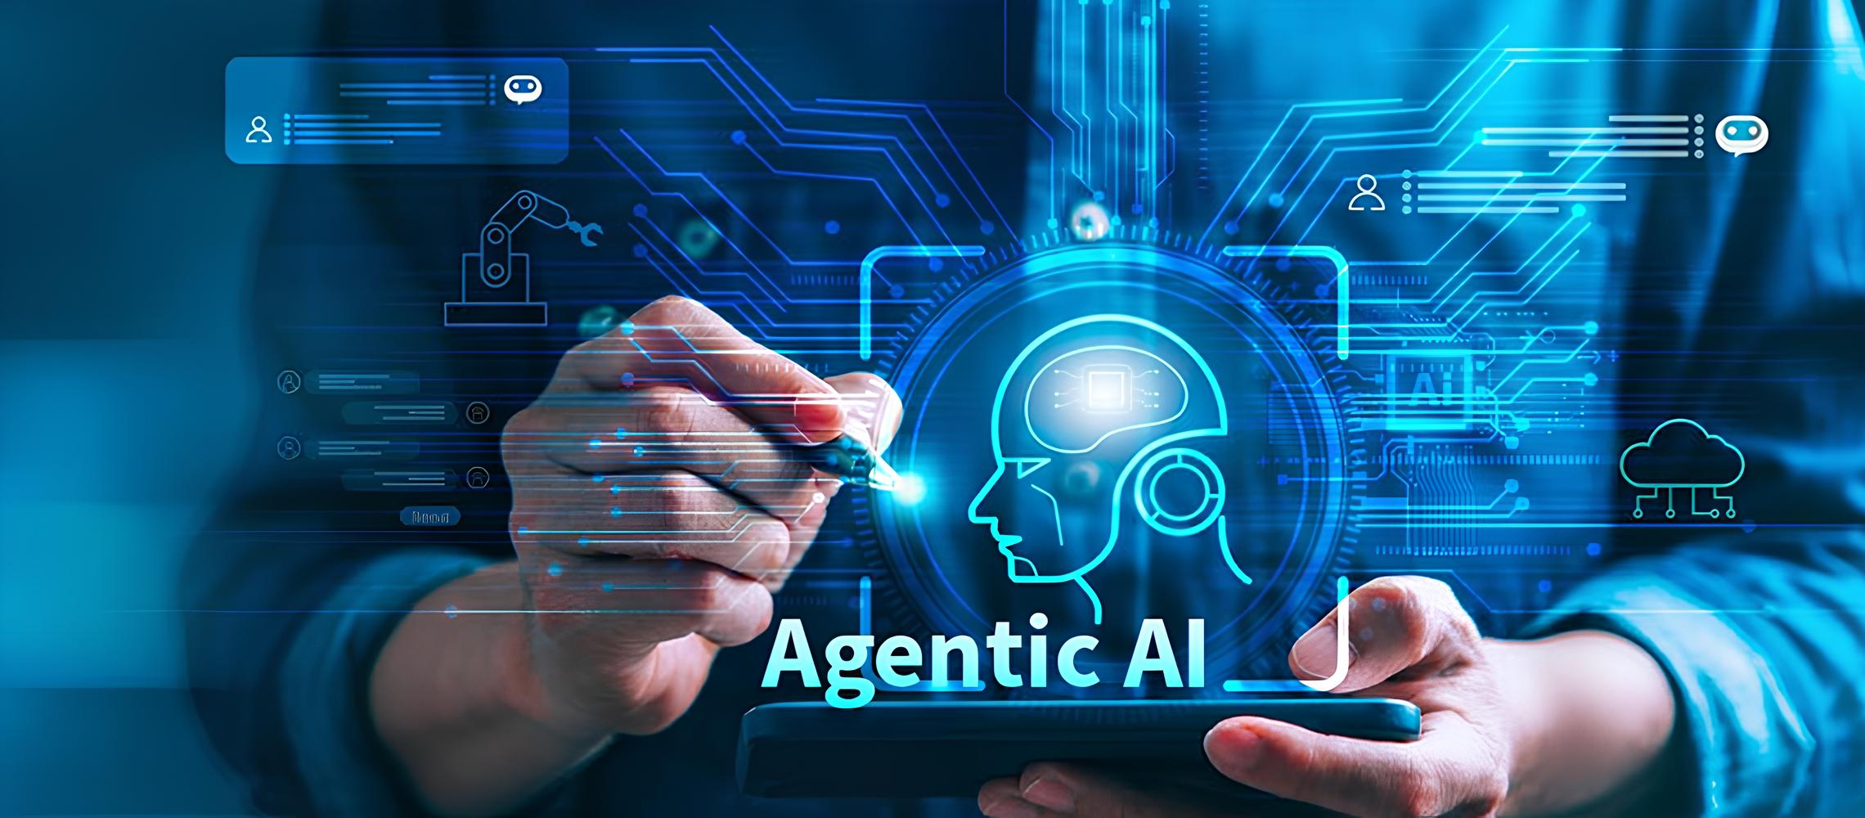
Agentic AI architecture
Resume Parser Agent: extract structure skill and tool from resumes using nlp technique and a curated skill taxonomy
Gap Analysis Agent: matches user skills with real world job description to identify and prioritize missing competencies, while also generating a job readiness score based on skill coverage
Learning Path Agent: generate a 3-phase roadmap using curated learning resources aligned with skill gaps
Workflow: Resume → Skill Extraction → Gap Computation → Personalized Multi-Phase Roadmap

Slide 7






Tech stack
Frontend: –Core Technologies: HTML5, CSS3, Vanilla JavaScript
Backend & Agents: –framework: flask
–al/ml: LangGraph, LangChain, OpenAI GPT-4o, LangSmith
–environment variables: OPENAI_API_KEY and LANGSMITH_API_KEY
Data & Storage: – data handling : json – version control : git, github
– deployment : render

Slide 8
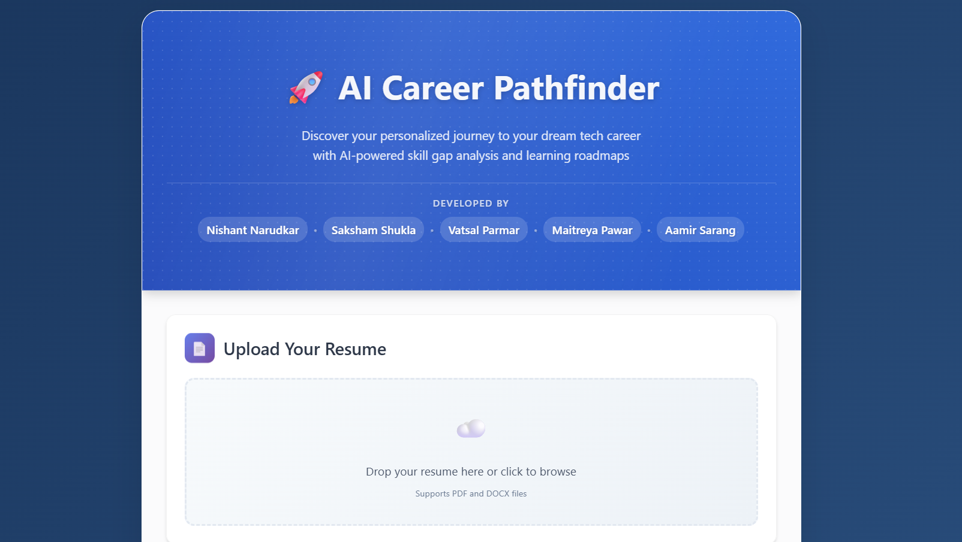
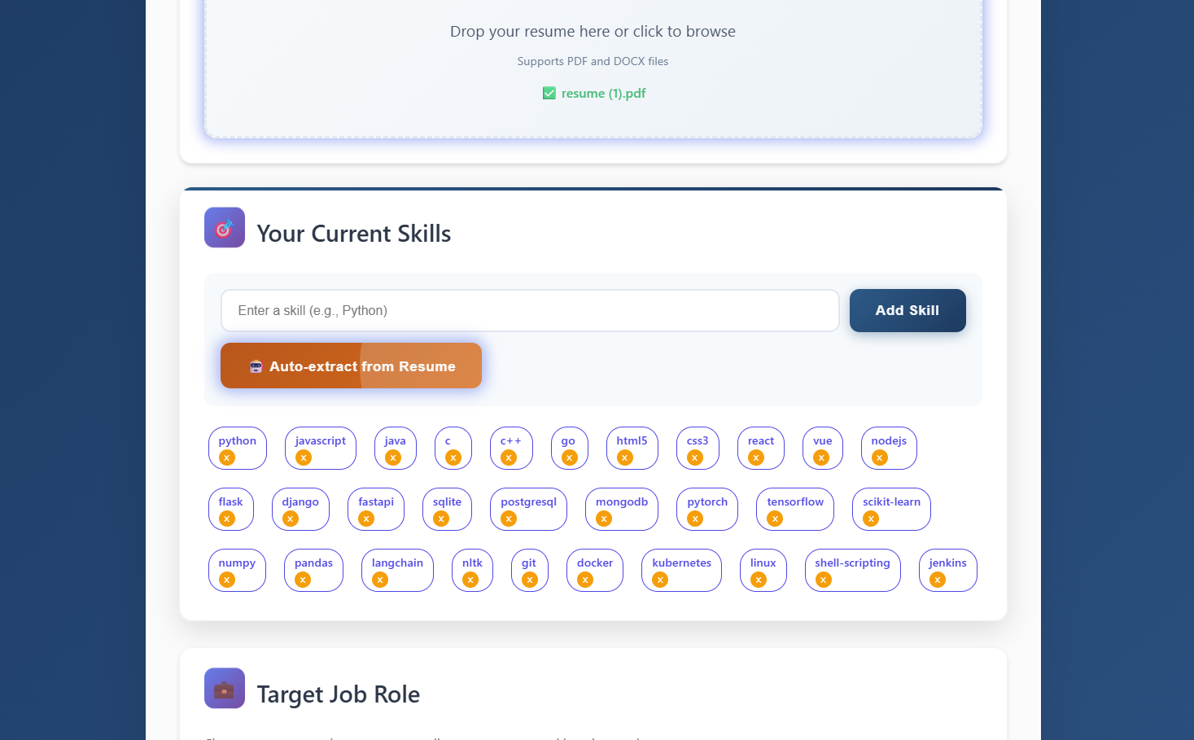
Preview of the website
Interactive upload interface allows users to seamlessly submit their resume for personalized analysis
AI Agent automatically extracts key technical and soft skills from the uploaded resume using NLP techniques

Slide 9
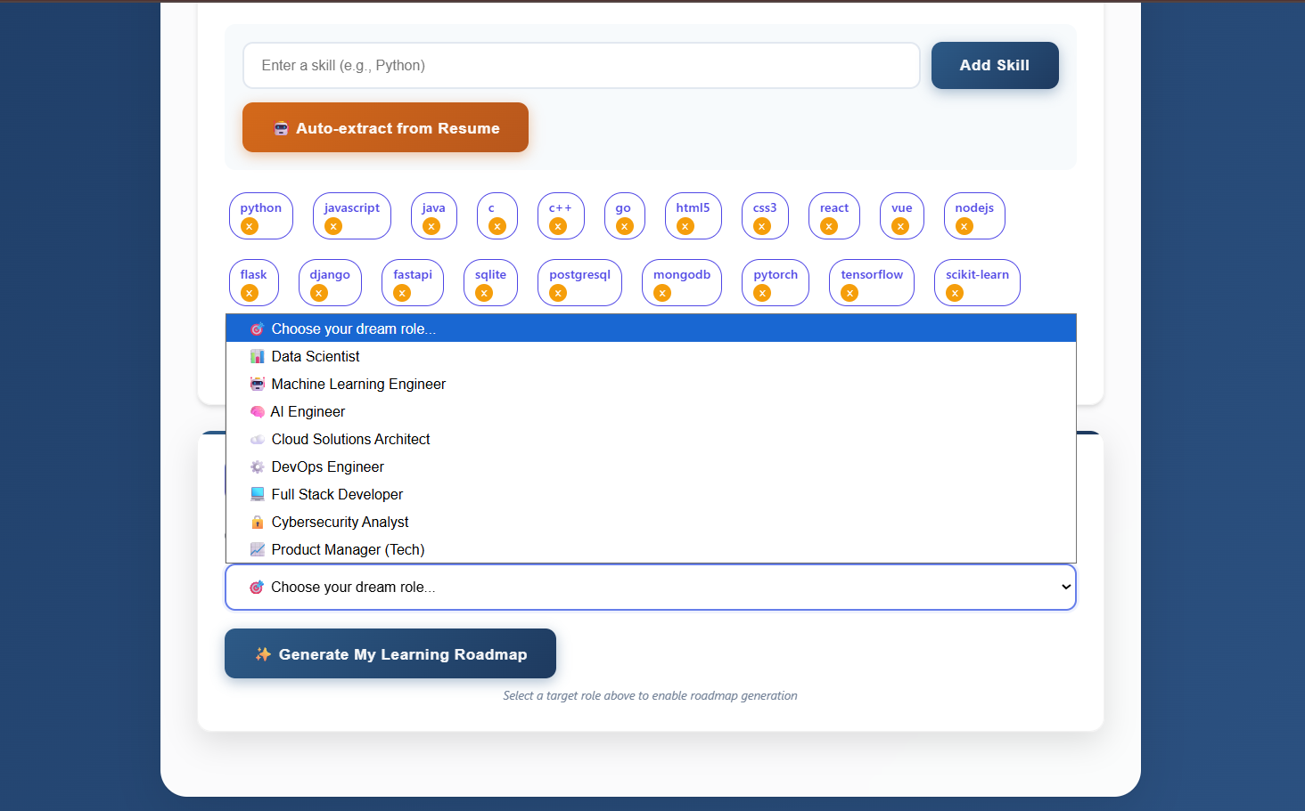
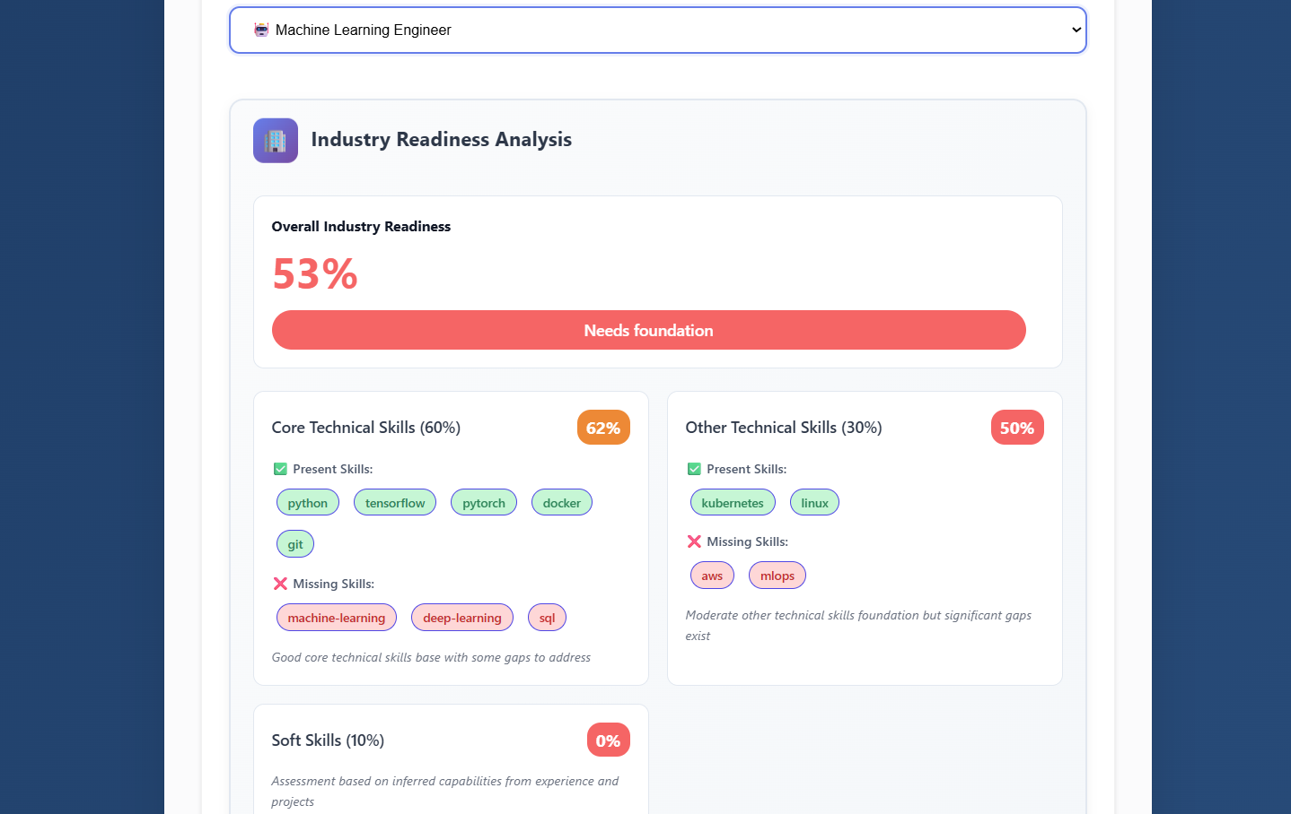
Users can select their target career role to personalize the skill-gap analysis and roadmap
Automatically generates an industry readiness score based on the user’s skill profile

Slide 10
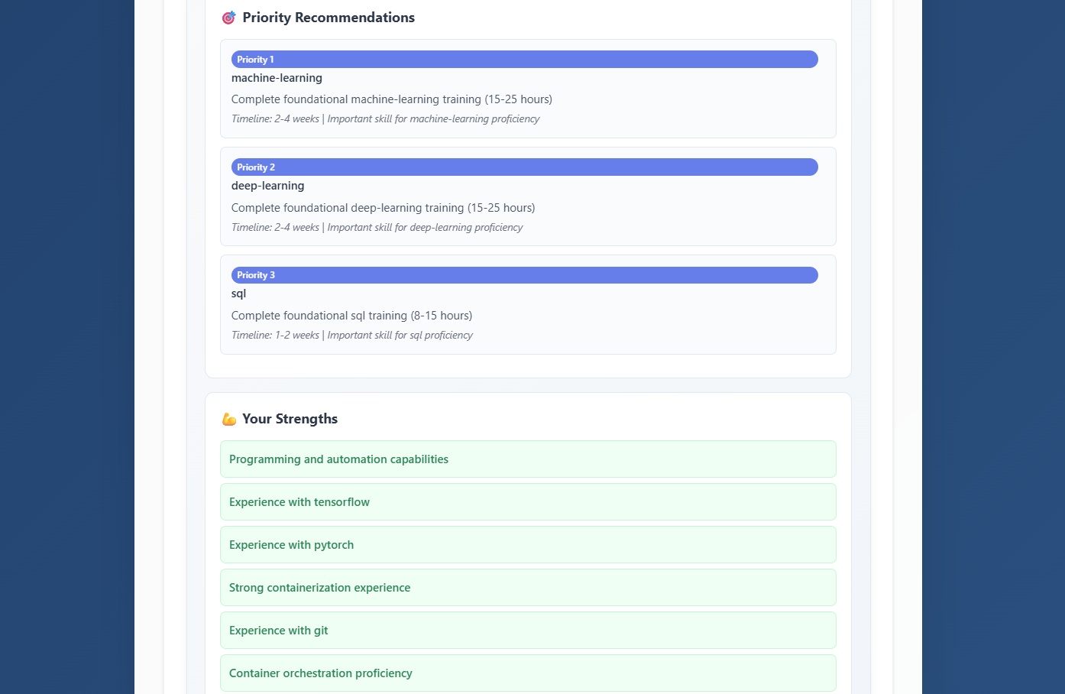
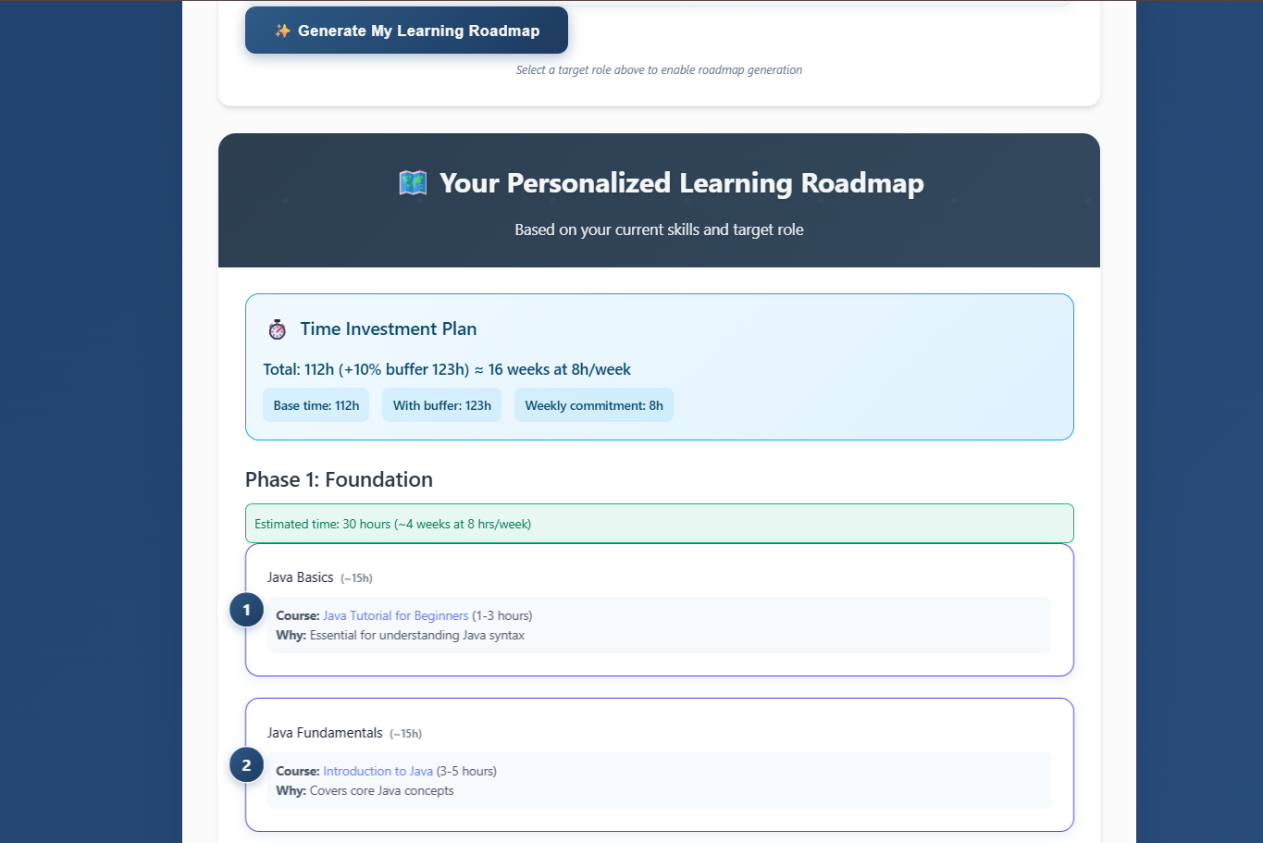
Displays the user’s current strengths and prioritizes skill gaps to enable focused, effective learning
With a single click, learners receive a personalized, phased roadmap with estimated time commitments and direct course links.

Slide 11
Project links
Live deployed website (render) :
https://ai-powered-career-pathfinder-navigator.onrender.com
Github repository
https://github.com/nishnarudkar/AI-Powered-Career-Pathfinder-Navigator

Slide 12
CONCLUSION
We developed a fully functional web application leveraging Agentic AI to deliver career-aligned skill insights and personalized upskilling paths.
The platform intelligently analyzes resumes, identifies missing competencies, and recommends curated learning content across three learning phases.
It demonstrates the power of AI agents in solving real-world challenges in education, skill development, and employability.
Future scope includes expanding to more job roles, improving resume parsing accuracy, and integrating personalized progress tracking for long-term growth.
With its real-world utility and scalable design, the Career Pathfinder is more than a prototype — it’s a step toward personalized, intelligent career development.

